Slide 1
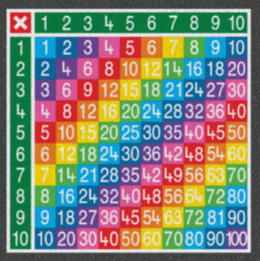

Multiplication Check 2025
Presentation for Parents and Carers
Confident, Compassionate and Curious

Slide 2
Important information about multiplication tables check (MTC)
-The MTC determines if Year 4 children can fluently recall their multiplication tables.
-They are designed to help schools identify which children require more support to learn their times tables.
-The Department for Education (DfE) will create a report about the overall results across all schools in England, not individual schools.

Slide 3
But what is so special about tables?
But what is so special about tables?
Division
Fractions
Percentages
Long Multiplication
Number sequences
Algebra
Problem solving…..
Increasing recipe amounts, calculating raw material usage in building projects, extrapolating survey results.
In fact, every walk of life….

Slide 4
Multiplication facts underpin so many other aspects of the curriculum for future learning. If children are not fluent with them, it will hinder their progress later on.
In order for children to be successful in maths and therefore successful in the Year 6 SATs test children need to be fluent in times-tables.
Fluency is not just about being able to recite tables in order: it is being able to recall a random fact in quick time- knowing what 7 x 8 is without having a resource to start at.

Slide 5
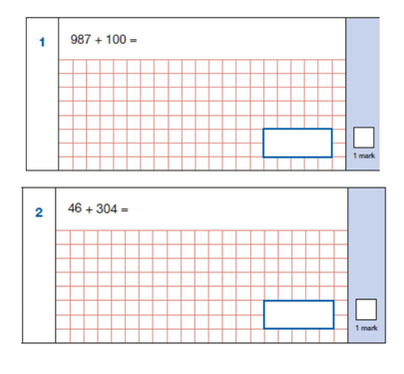

Slide 6
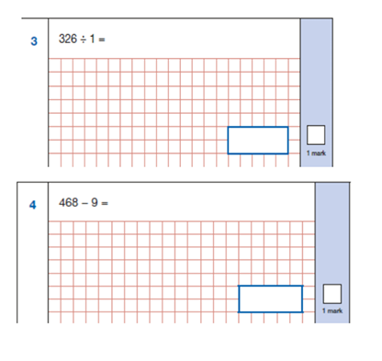

Slide 7
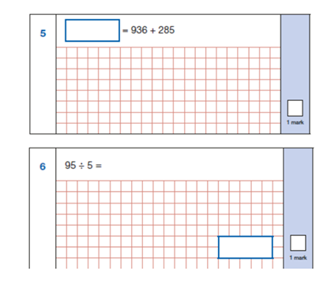

Slide 8
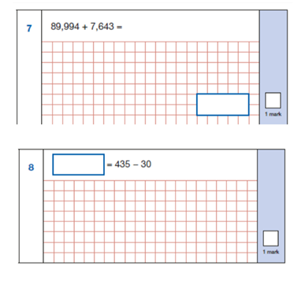

Slide 9
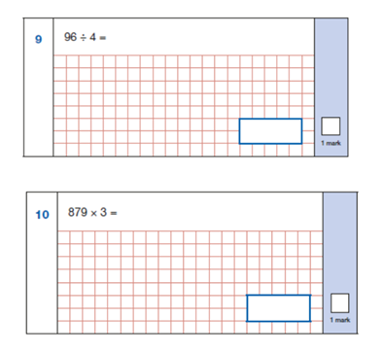

Slide 10
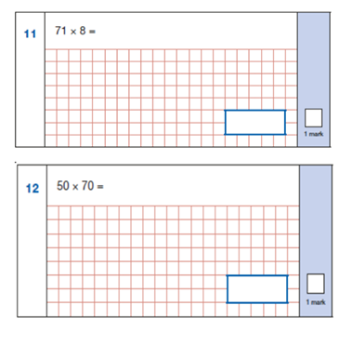

Slide 11
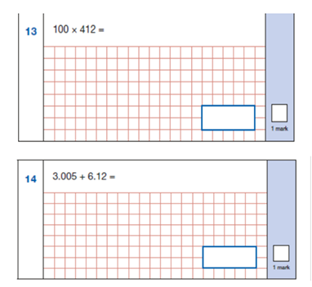

Slide 12
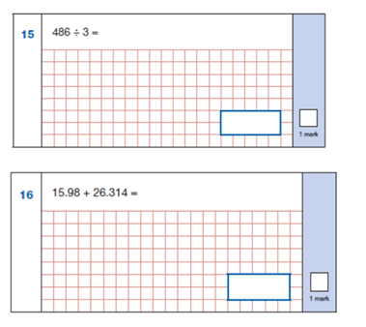

Slide 13
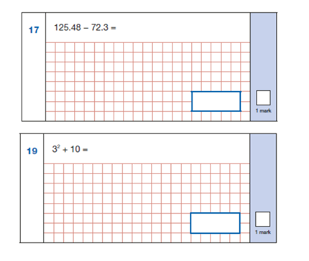

Slide 14
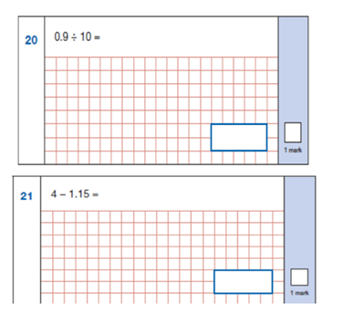

Slide 15
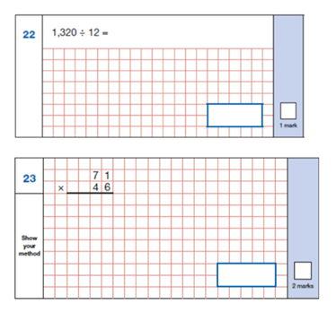

Slide 16
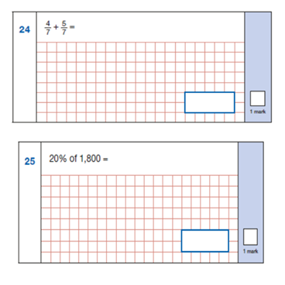

Slide 17
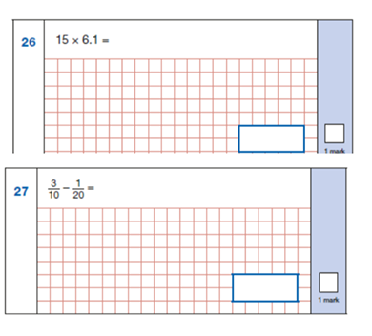

Slide 18
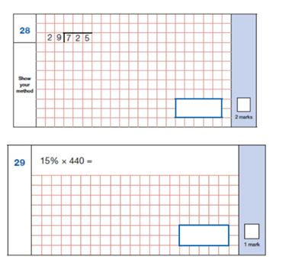

Slide 19
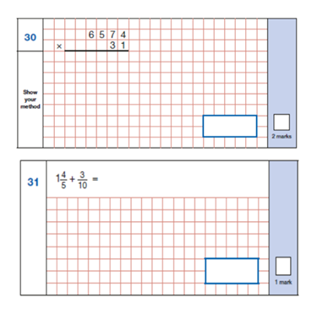

Slide 20
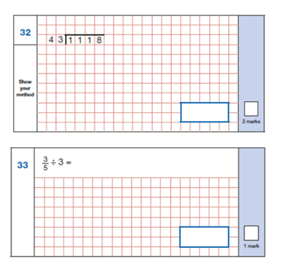

Slide 21
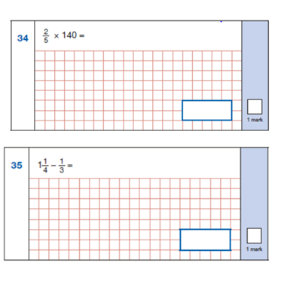

Slide 22
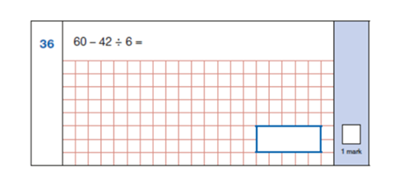
25 marks in this paper require an element of tables knowledge.

Slide 23
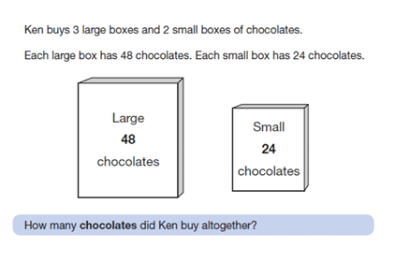

Slide 24
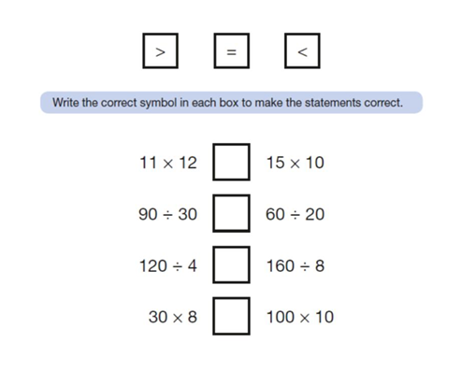

Slide 25
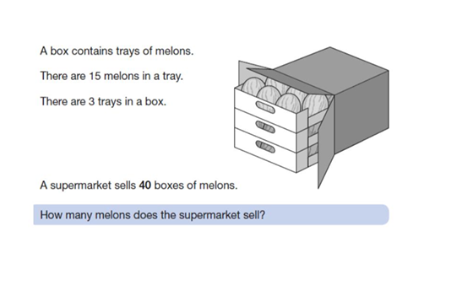

Slide 26
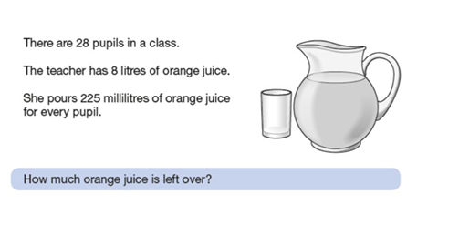

Slide 27
More information about the questions
The Standards and Testing Agency (STA) state that they are classifying the multiplication tables by the first number in the question. For example, 8 x 3 would fall within the 8 times table.
There is an emphasis on the 6, 7, 8, 9 and 12 multiplication tables because these have been determined to be the most difficult multiplication tables.

Slide 28
How the check is carried out
The check will be fully digital.
Answers will be entered using an on-screen number pad.
Usually, the check will take less than 5 minutes for each child.
The children will have 6 seconds from the time the question appears to input their answer. We train the children to use this time even if they are speedy and accurate.
There will be a total of 25 questions with a 3 second pause in-between questions.
There will be 3 practice questions before the check begins.

Slide 29
How the check is carried out
Each child will be randomly assigned a set of questions
There will only be multiplication questions in the check, not division facts.
The 6, 7, 8, 9 and 12 times tables are more likely to be asked. Reversal of questions (e.g. 8 x 6 and 6 x 8) will not be asked in the same check.
Children will not see their individual results when they complete the check.
All children will take the test, some may receive support to do so.
They may not all take it on the same day.
There is no pass mark (or is there?).

Slide 30
How the check is carried out
There will be a window from Monday 2nd June to Friday 13th June 2025 for schools to administer the check.
There is no set day to administer the check and children are not expected to take the check at the same time.
All eligible Year 4 children in England will be required to take the check.
We will get children to sit in a quiet room with a known adult.
There are 3 practice questions prior to the test and then there are 25 questions.

Slide 31
Ways to support times table knowledge
Count and look for patterns.
Understand that multiplication is repeated addition. (Knowing that 2x4 is the same as 2+2+2+2)
Remember that multiplication is commutative. (5x3 is the same as 3x5)
Remember that multiplication is the inverse of division.
(20 ÷ 5 = 4 can be worked out because 5 x 4 = 20)
Recall and utilise number families.
4 x 6 = ?
I know 4 x 5 = 20
Therefore, 20 + 4 = 24
By using known facts from ‘easier’ times tables, children should be able to find answers with increasing speed.

Slide 32
How best to prepare your child for the check
Talk positively about the check. Remind them that the check should last no more than 5 minutes.
If you want to go over times tables, make them fun.
If you have any concerns, talk to your child’s teacher.
If your child has any concerns, encourage them to talk to a trusted adult (for example, yourself, their teacher).
If you’re looking to support your child further with maths at home, there are lots of good websites with free resources.
- https://ttrockstars.com/
- https://www.timestables.co.uk/multiplication-tables-check/
- https://mathsframe.co.uk/en/resources/resource/477/Multiplication-Tables-Check
- https://talkingtimestables.uk/y4_ks2_mtc_practice_tests_multiplication_tables_check.php

Slide 33

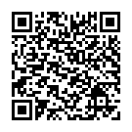
Your turn!
Have a go yourself- we promise we won’t ask for your scores!

